Slide 1
CS2105 Introduction to Computer Networks

Slide 2
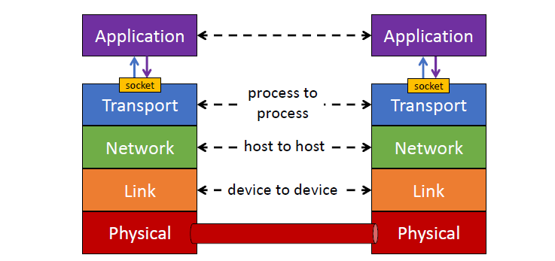
Recap
Sockets
Interface through which a process (application) communicates with the transport layer
Notes:
Depending on UDP TCP, different kinds of sockets: welcome/server socket
Sockets are used differently by the protocols
For eg, demultiplexed differently
UDP – destination IP, destination port (identify source by network layer)
TCP – source IP, source port, destination IP, destination port

Slide 3
Recap
Socket programming
TCP
Stream socket
Connection Oriented
Reliable
UDP
Datagram socket
Connectionless
Unreliable
Notes:
To draw parallel with the 2 different kind of networks we learnt before (circuit and packet switching)

Slide 4
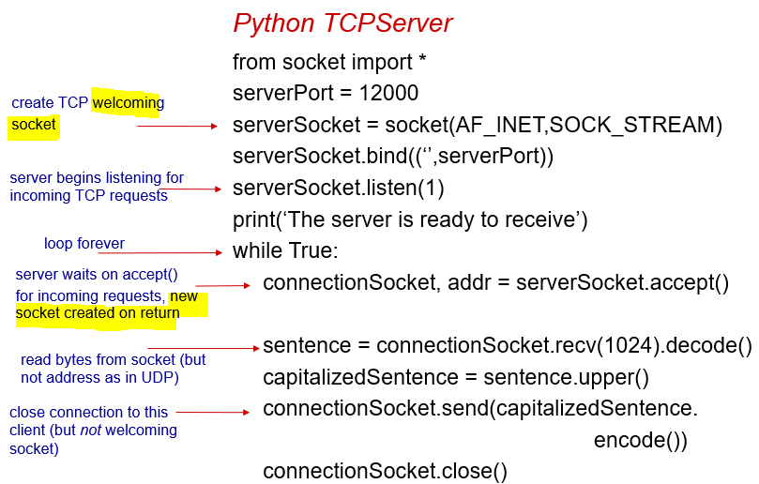
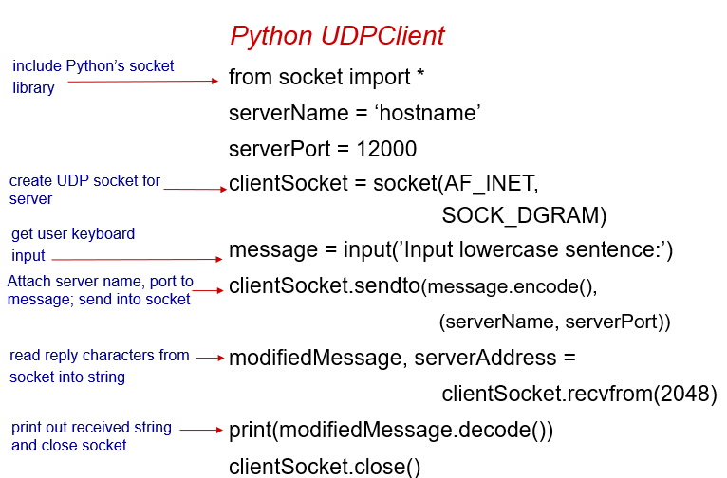
Recap
Notes:
Notice the difference!

Slide 5
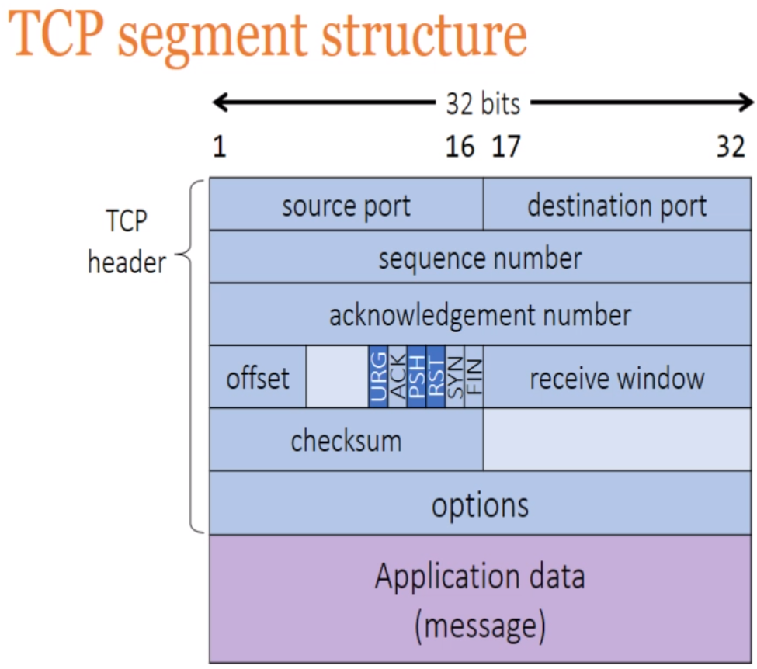
Recap
TCP
Maintains a welcome socket
Acts an ‘usher’
Does not directly participate in message passing
When contacted by client, server TCP will create a new socket for server process to communicate with client
Clients can hence be identified by the TCP connection
➔ n+1 sockets needed for n connections
Notes:
Welcome socket analogous to a maître d (head waiter) of a restaurant.
He mainly directs the customers to their tables, and then the little waiters will serve each table individually. The maitre d(welcome socket) does not serve directly.
This socket’s primary role is to listen on that port to establish connections.
As you will soon find out, there is a lot of other information that needs to be maintained for each connection:
client's IP address and source port
TCP packet ID sequences
TCP window size and send rate
incoming and outgoing data
Hence, welcome socket ‘outsources’ this information to another socket. This socket will have another port number, which will be mapped to the client’s IP address and source port, allowing the server to know which socket is talking to which process of which end host.
Distinguishing the 2 types of sockets allows for connections to be closed while still accepting new incoming connections and maintaining current connections while rejecting any new incoming connections ☺
Offset is basically length of header: what is the offset from which the message starts

Slide 6
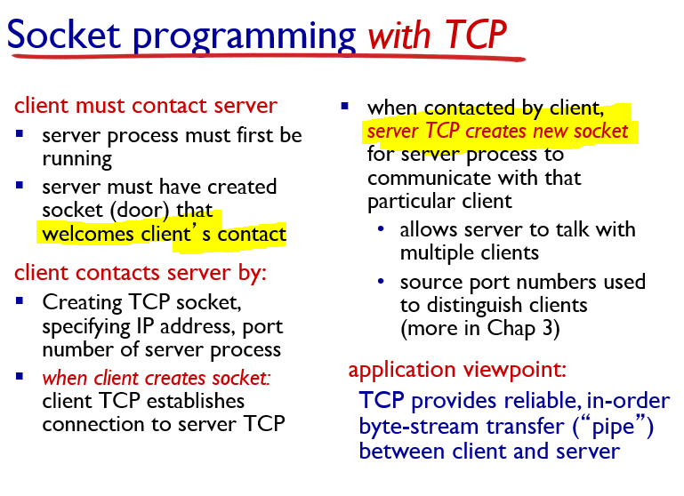
Recap

Slide 7
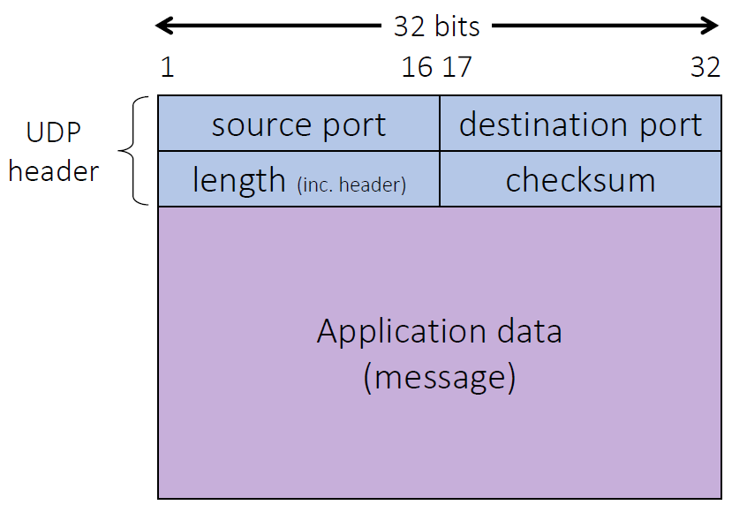
Recap
UDP
For each port #, only 1 socket to serve all connections
IP datagrams from multiple sources with the same destination port # will be directed to the same UDP socket at destination (like a mailbox)
Connectionless demultiplexing
Attach the destination IP address and port number to each datagram
To send responses to requests, extracts client’s IP address from IP header
Client’s port can be found here>>

Slide 8
Recap
Checksum
Able to detect single bit flips
Sender
Compute checksum value and places the 1s complemented version in checksum field
Receiver
Computes its own variation of checksum and adds it to the checksum found
If there is a 0 anywhere ➔ corrupted!

Slide 9
Tutorial Questions

Slide 10
Question 1
Launch your browser and open its network diagnostic tool (e.g. press F12 if you use Chrome on Windows, or Cmd + Opt + I for Mac). Then click the “Network” tab to observe network communication. Copy-and-paste the following URL in the address bar of your browser: http://tiny.cc/atupaz. Enter your choice and press the “Submit” button.
a) Look at the entry named “formResponse”. What is the HTTP request method issued?
POST
b) Briefly explain when HTTP POST and GET methods are used.
(From Wikipedia) The POST request method requests that a web server accepts and stores the data enclosed in the body of the request message. It is often used when uploading a file or submitting a completed web form. In contrast, the HTTP GET request method is designed to retrieve information from the server.

Slide 11
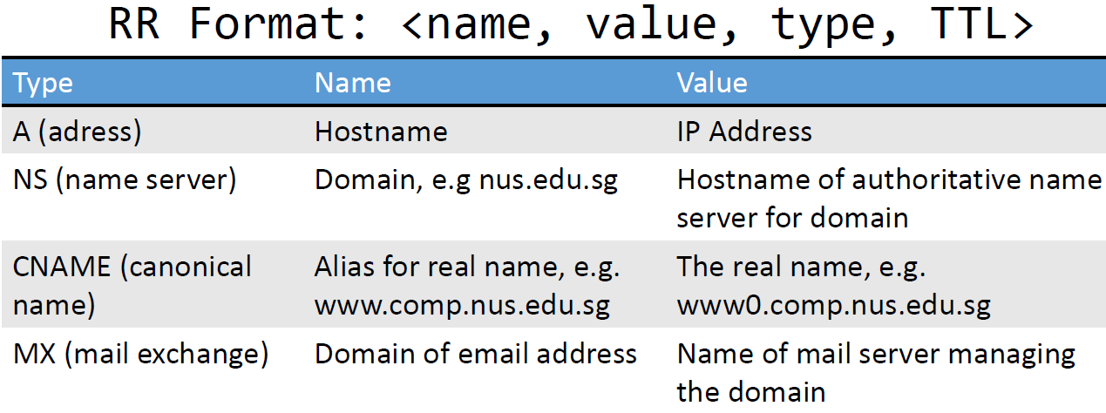
Question 2
[KR, Chapter 2, P21] Suppose that your department has a local DNS server for all computers in the department. You are an ordinary user (i.e. not a network/system administrator). Can you determine if an external Web site was likely accessed from a computer in your department a couple of seconds ago? Explain.
You may use ‘dig’ (domain information groper) program to query the local DNS server. For example,
dig –t a www.abc.com
If IP address of this Web page has been queried by another computer seconds ago, your local DNS server should keep this knowledge in local DNS cache and is able to answer your query quickly. Otherwise, the query time will be long.
Notes:
-t flag specifies the type; hence the above command issues a dns query that is only interested in responses tagged with type ‘A’ i.e. IPv4 addresses

Slide 12
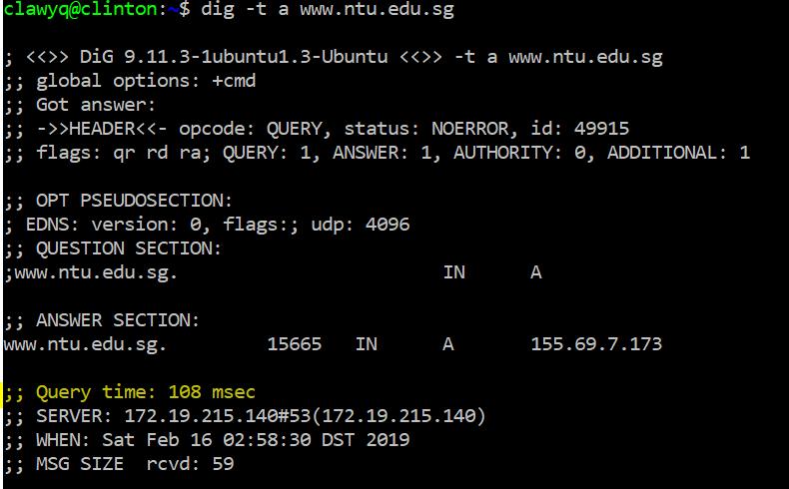
Question 2
1st run:

Slide 13
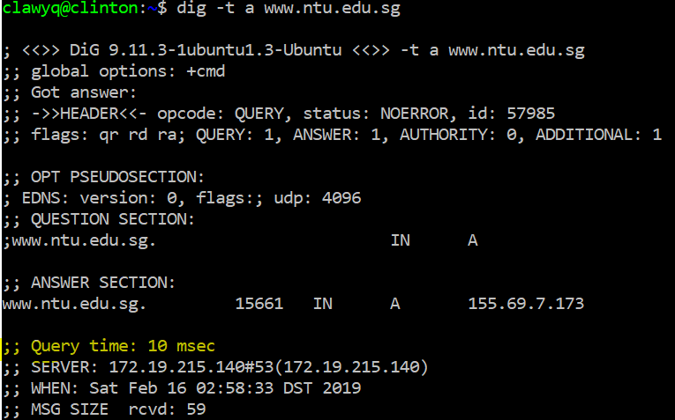
Question 2
2nd run:
Notes:
Note that there might be multiple address entries in the answer section a single host name => this is for load balancing ☺
You can prioritise which servers they want to send traffic to too
AAAA => ipv6

Slide 14
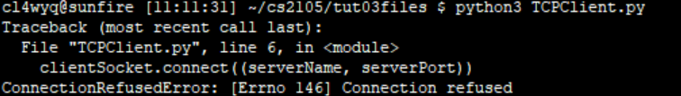
Question 3
[Modified from KR, Chapter 2, P31] You are given 4 programs: TCPEchoServer.java, TCPEchoClient.java, UDPEchoServer.java and UDPEchoClient.java. Compile them on sunfire.
a) Suppose you run TCPEchoClient before you run TCPEchoServer. What happens? Why?
When creating a local socket, client attempts to make a TCP connection to a non-existent server process. Exception will be thrown.
b) Suppose you run UDPEchoClient before you run UDPEchoServer. What happens? Why?
UDP client doesn’t establish connection to server when creating local socket. Thus it works fine if you start client program first and then server program (but data sent to server are all lost).

Slide 15
Question 4
[KR, Chapter 3, R7] Suppose a process in Host C has a UDP socket with port number 6789. Suppose both Host A and Host B each sends a UDP segment to Host C with destination port number 6789. Will both of these segments be directed to the same socket at Host C? If so, how will the process at Host C know that these two segments originated from two different hosts?
Yes, both segments will be directed to the same socket. DatagramPacket class provides a method getAddress() for us to learn the IP address of the origin of a packet.
The question is really asking: since UDP does not have a specific connection for each client for ease of identification, how can I tell where did the message come from?
By extracting the IP address from the IP header as discussed earlier.

Slide 16
Question 5
Suppose you have the following 2 bytes: 01011100 and 01100101. What is the 1’s complement of the sum of these 2 bytes?
Sum: 11000001, checksum: 00111110
Suppose you have the following 2 bytes: 11011010 and 01100101. What is the 1’s complement of the sum of these 2 bytes?
Sum: 01000000, checksum: 10111111
Notes:
1s complement (addition and adding the carry back to the least significant bit)

Slide 17
Question 6
[Modified from KR, Chapter 3, Problem 5] Suppose that UDP receiver computes the checksum for the received UDP segment and finds that it matches the value carried in the checksum field. Can the receiver be absolutely certain that no bit errors have occurred? You may use Q5 as an example to explain.
If sender transmits the following two bytes: 01011100 and 01100101, and the two highlighted bits flip, then checksum remains unchanged and receiver will fail to detect this error. Checksum cannot pick up multi-bit flips!

Slide 18
Question 7
Why is it that UDP takes 1’s complement of the sum as checksum, i.e. why not just use sum? With the 1s complement scheme, how does the receiver detect errors?
Computation at receiver side is simplified. To detect errors, receiver adds all the 16-bit words (including the checksum). If the sum contains a zero, then receiver knows there has been an error. All one-bit errors will be detected, but some two-bit errors can be undetected. There is no need to compare received checksum with computed checksum bit by bit.

Slide 19
Question 8
In our rdt protocols, why did we need to introduce sequence numbers?
Sequence numbers are required for a receiver to find out whether an arriving packet contains new data or is a retransmission.

Slide 20
Question 9
Assignment 1 key specifications:
Implementation and design of a pseudo HTTP protocol
What are the valid requests and their associated responses?
What does it mean to be persistent?
What are the things I must implement for persistency?
How can I make my code reflect this persistency?
Think about what actually happens when you call a method.
E.g. what does calling .accept() actually do?
Reconcile this with what we’ve learnt in class

Slide 21
Summary
Sockets
TCP vs UDP
Methods for demultiplexing
Checksum

Slide 22
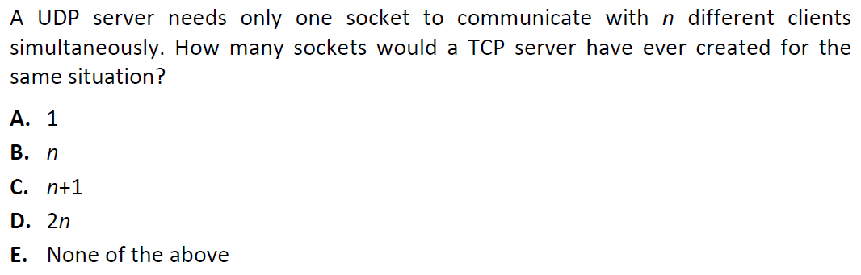
Extra Questions

Slide 23
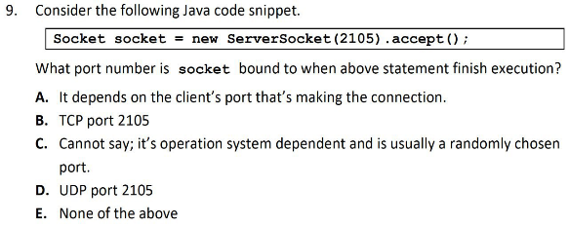
Extra Questions

Slide 24
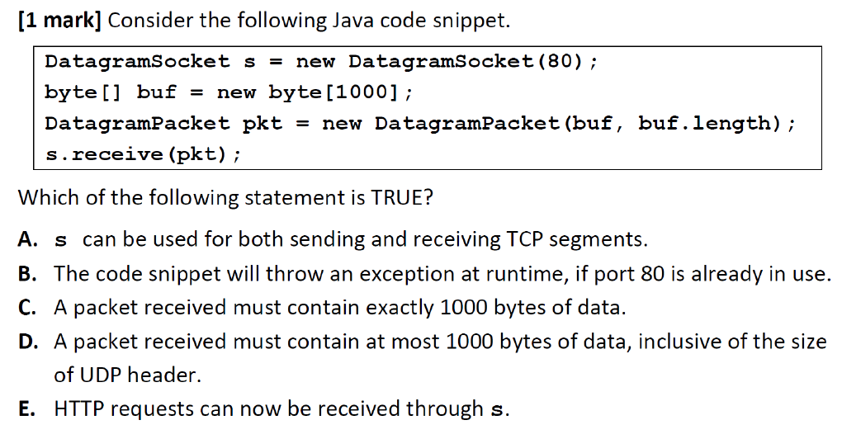
Extra Questions

Slide 25
Thank you!
Answers:
C, B, B

